Slide 1

TRAVELNOW!
Bringing pleasure back to business travel effortlessly

Slide 2

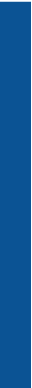
1
PROJECT OVERVIEW
VISION
Bringing pleasure back to business travel effortlessly
MISSION
Our mission at TravelNow! is to create an information space which seamlessly integrate business and travelling pleasure, thus enabling business travelers to easily discover, manage and connect with content relevant to their personal interests

Slide 3


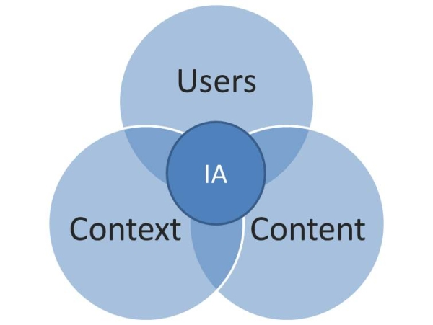
2
STRATEGY
Aligning the clients’ business goals with our mission to strategize solutions
Research to discover user needs and explore more targeted pieces of information
Imbibed our vision & research to approach all architecture & design keeping in mind the context, content and users

Slide 4
3
RESEARCH SWOT ANALYSIS
FEATURES | HIPMUNK | CTRIP | MOMONDO | KAYAK | EXPEDIA
Packages | * | * |  | * | *
Flights | * | * | * | * | *
Hotels | * | * | * | * | *
Car Rentals | * | * | * | * | *
Recommendations |  | * | * |  | *
Local Recommendations |  | *
Multimedia Recommendations |  | * | *
Maps synced with app/site |  | *
Calendar synced with app/site
Customized itinerary |  | * | * | *
Event Suggestions |  | *

Slide 5
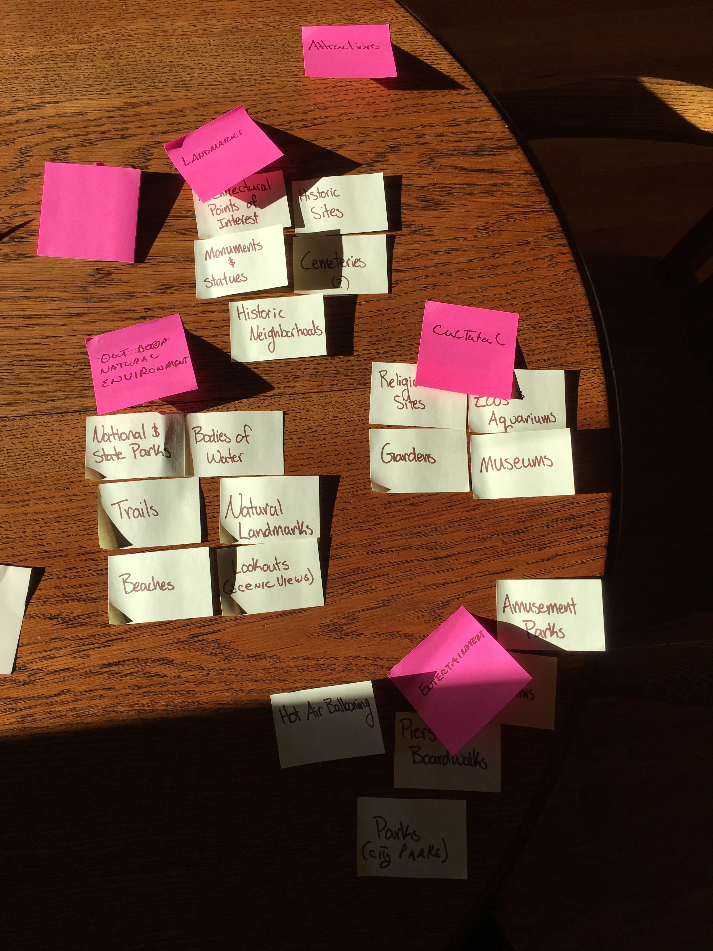
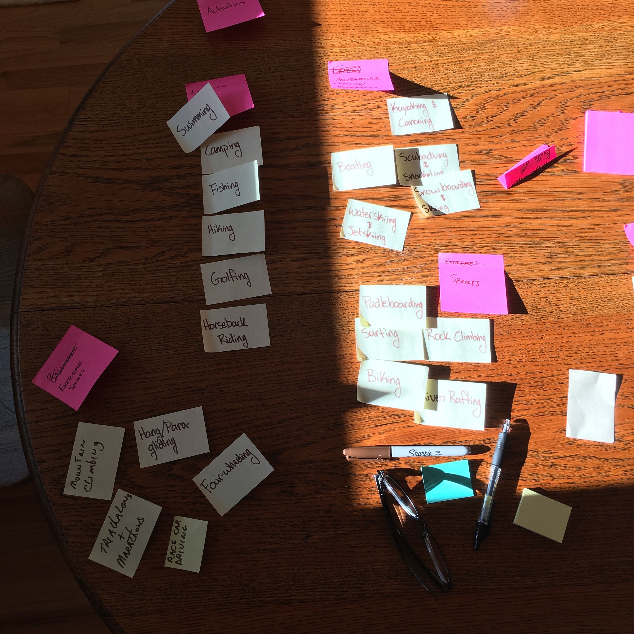
3
RESEARCH CARD SORTS

Slide 6
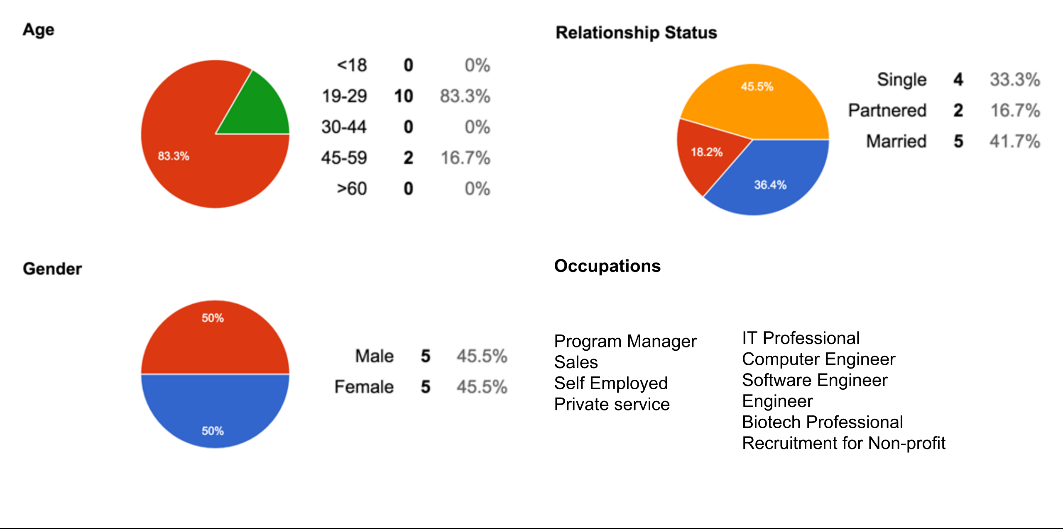
3
RESEARCH SURVEY

Slide 7
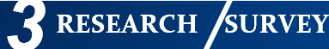


25%
75%

Slide 8
HOME PAGE WIREFRAME
Demonstration

Slide 9
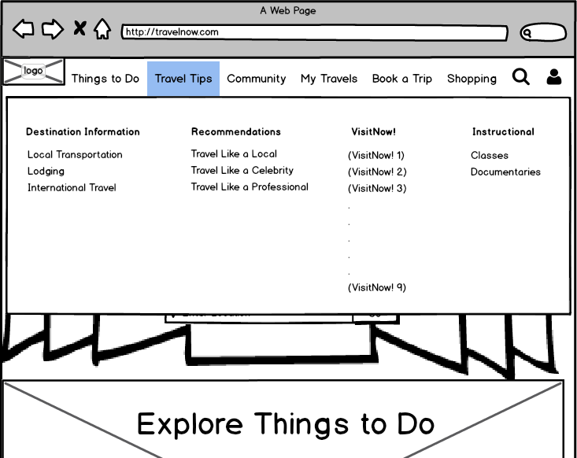
HOME PAGE NAVIGATION WIREFRAME

Slide 10
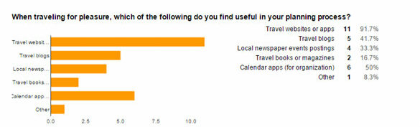
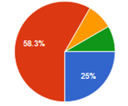
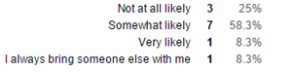
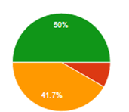
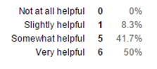
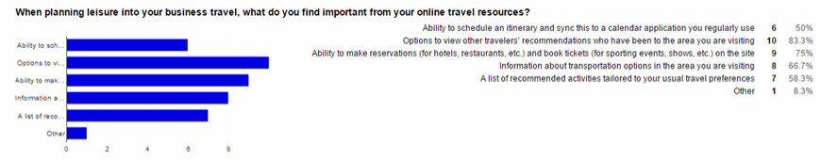
Likelihood of bringing a non-business travel partner
Seamlessly integrating detailed travel itinerary onto calendar

Slide 11
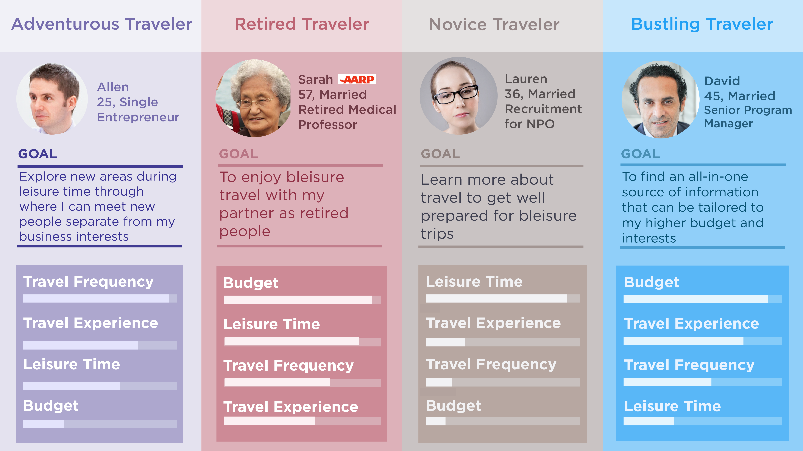

Slide 12
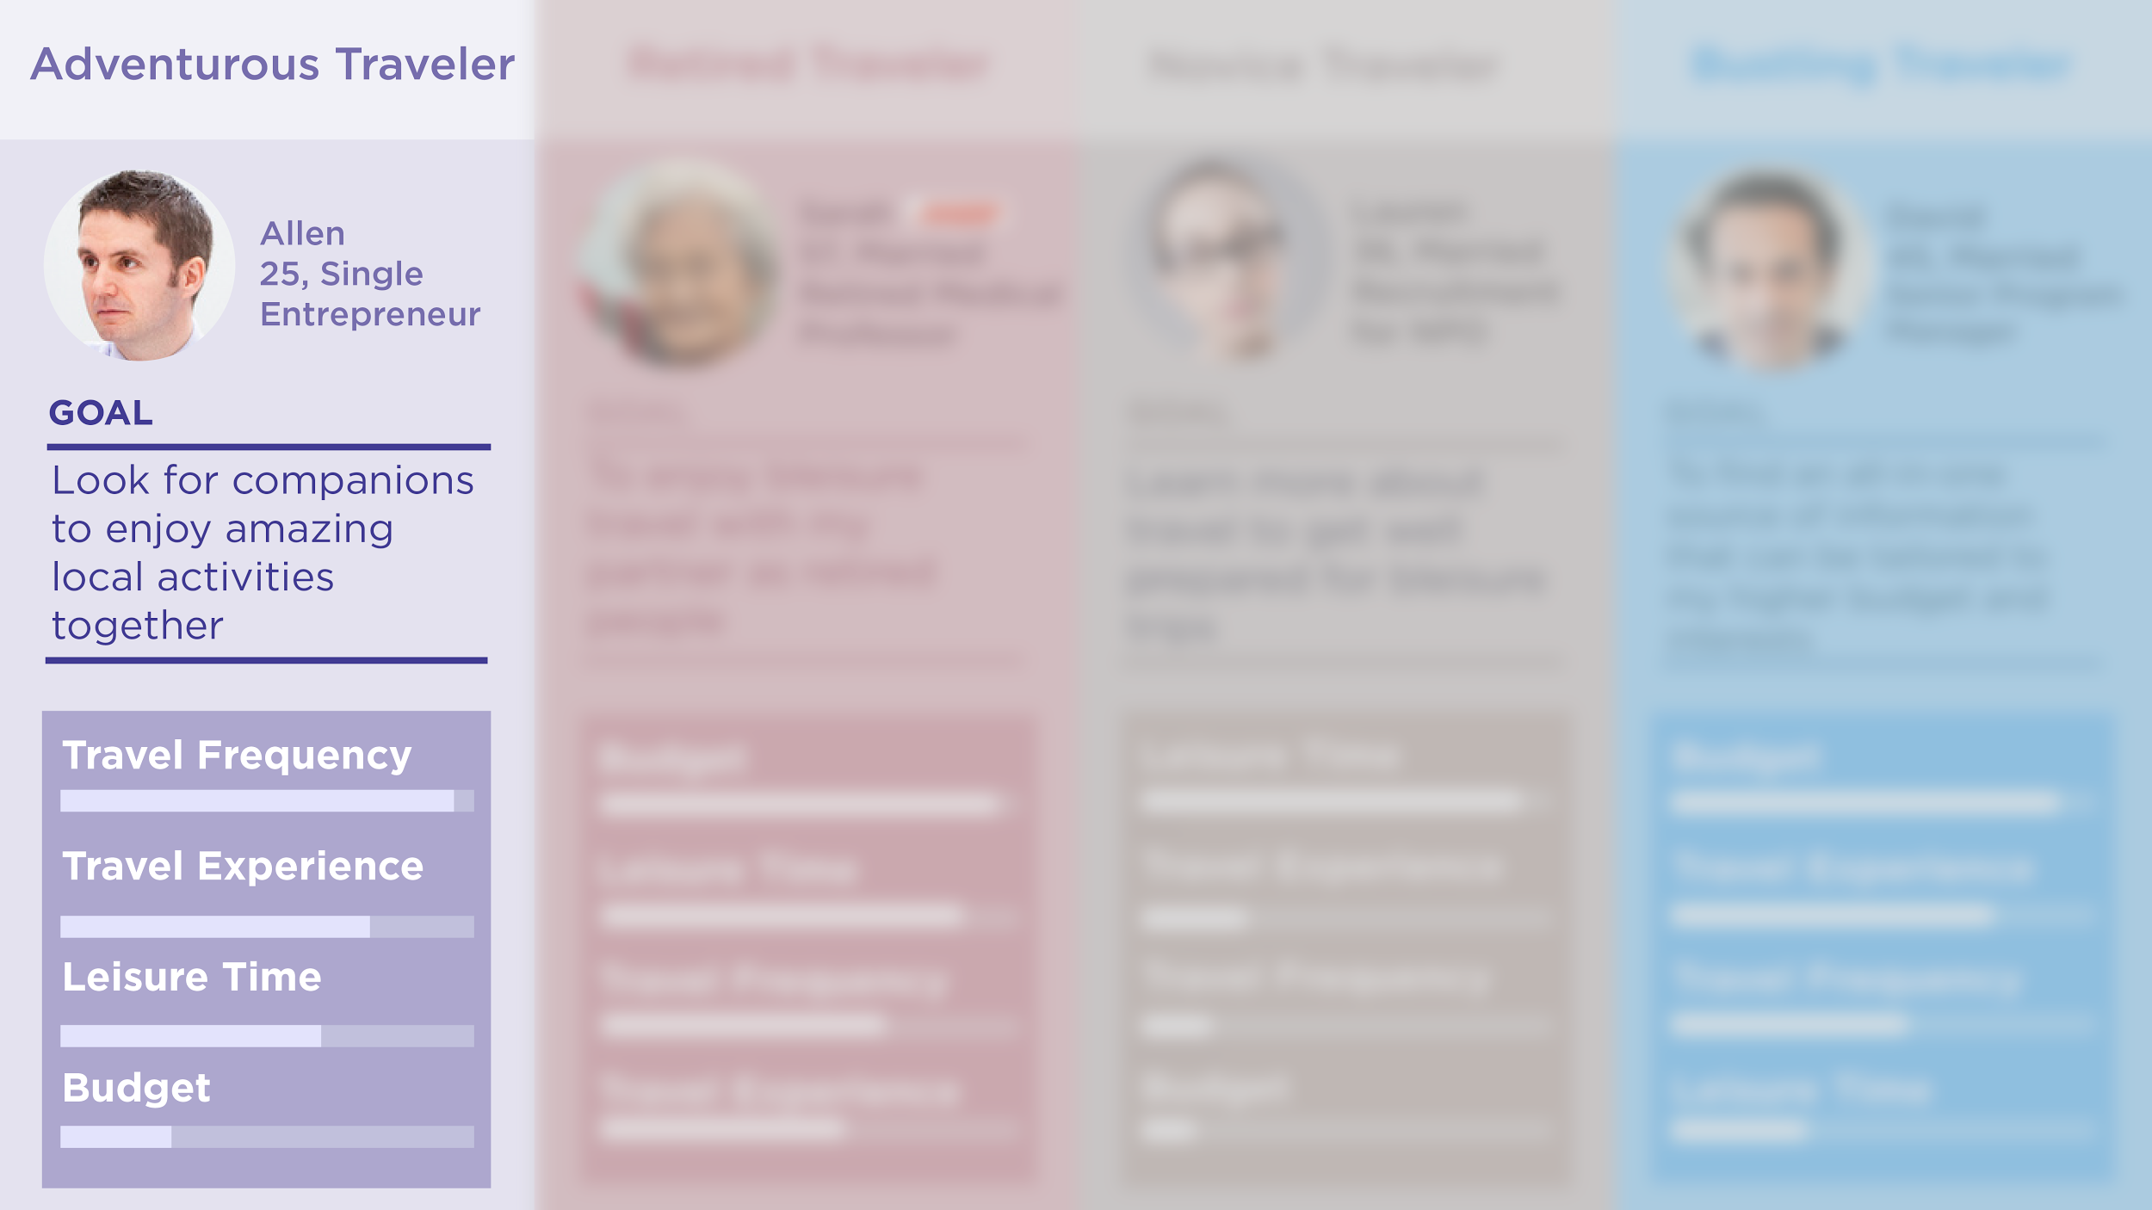

Slide 13
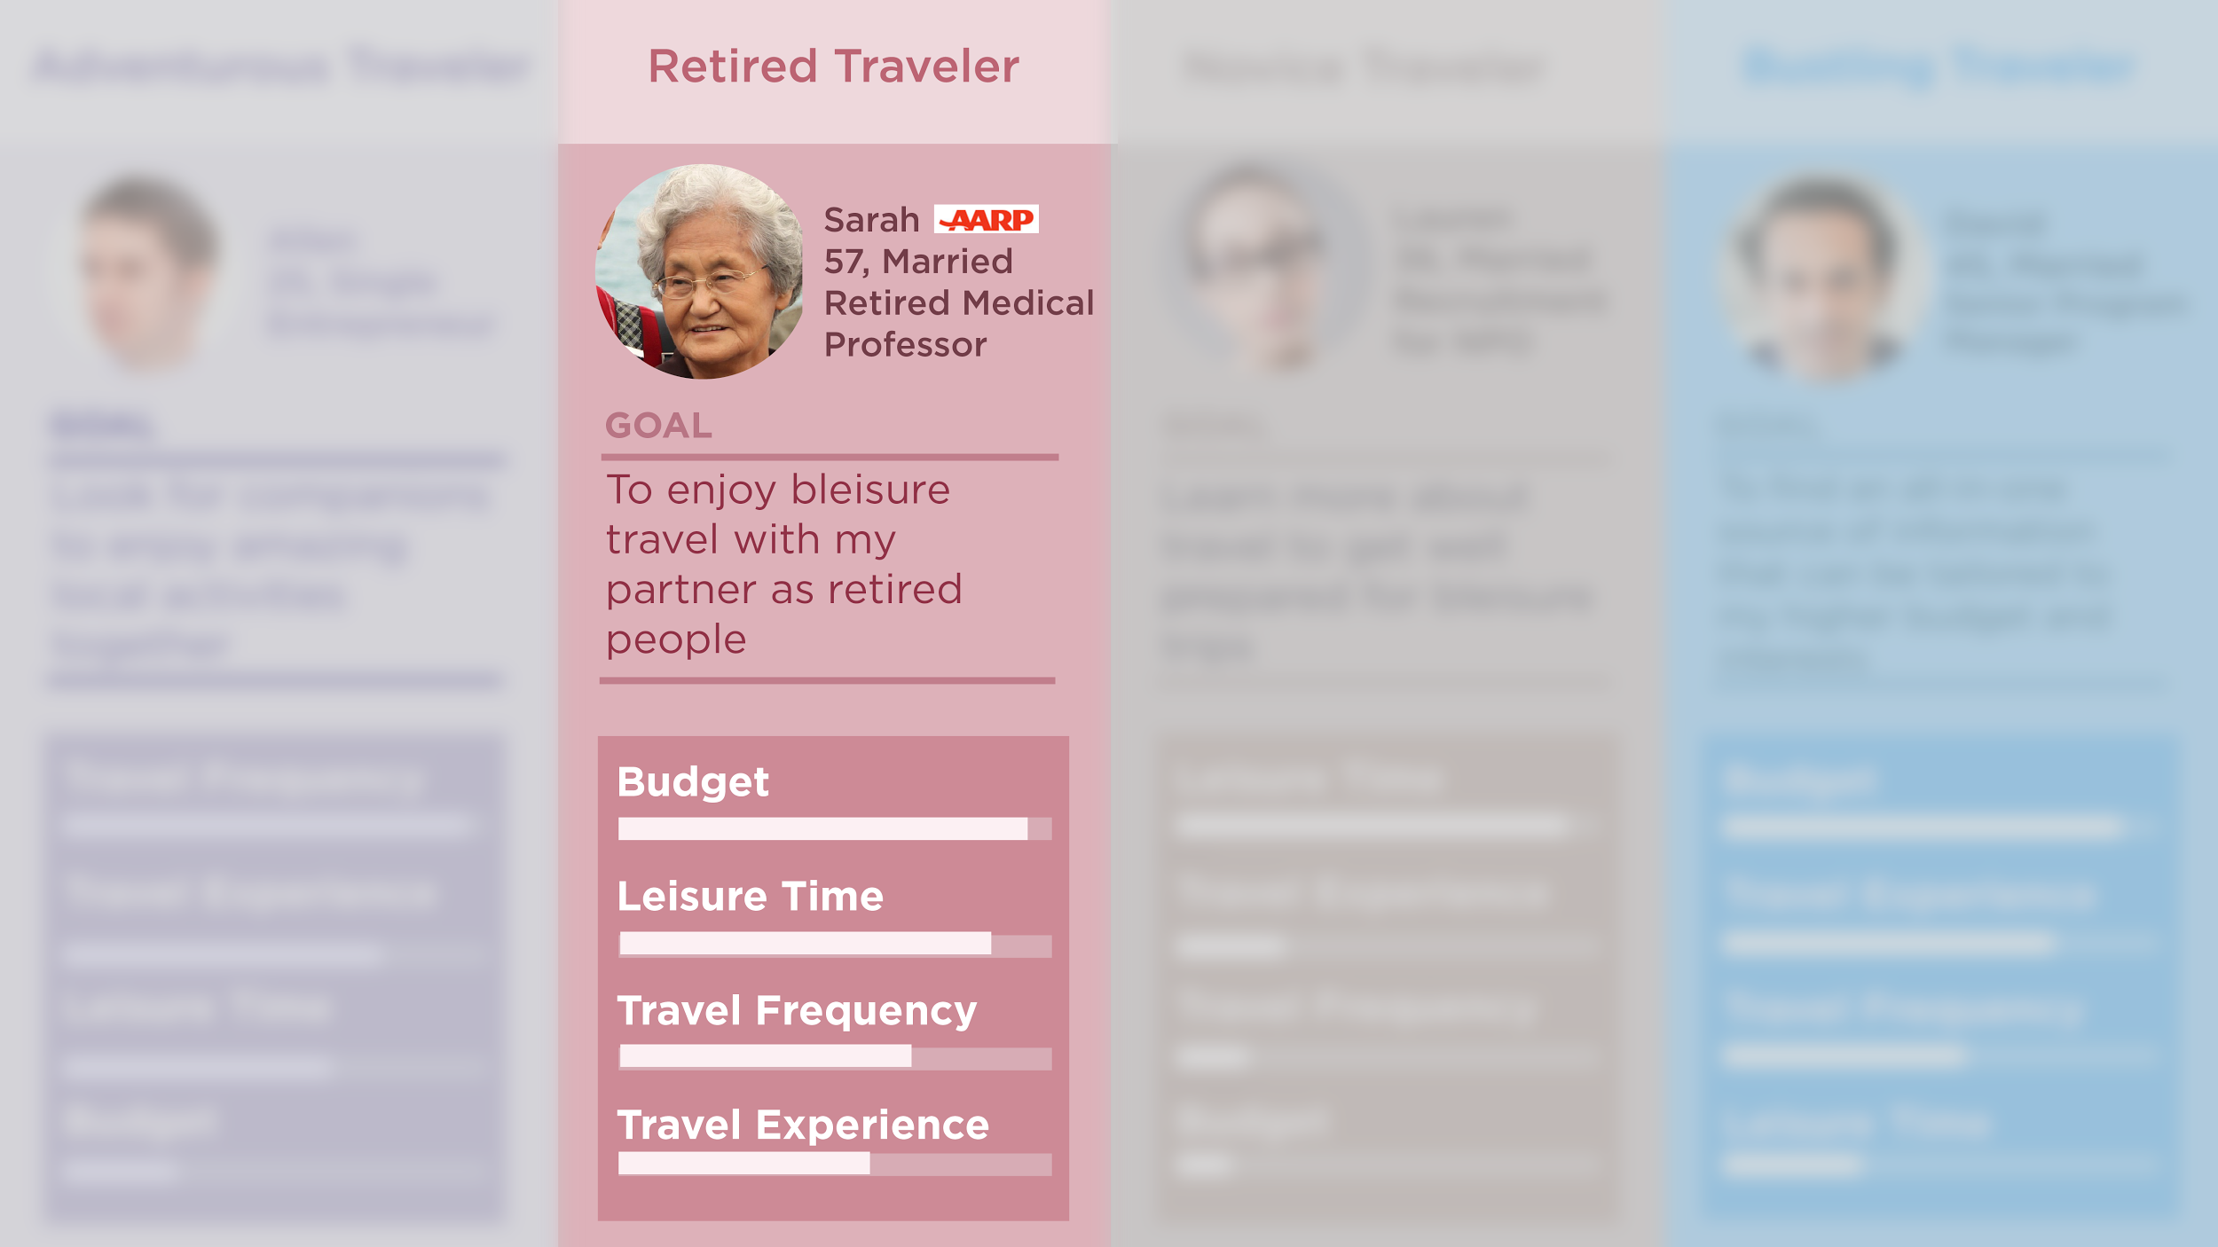

Slide 14
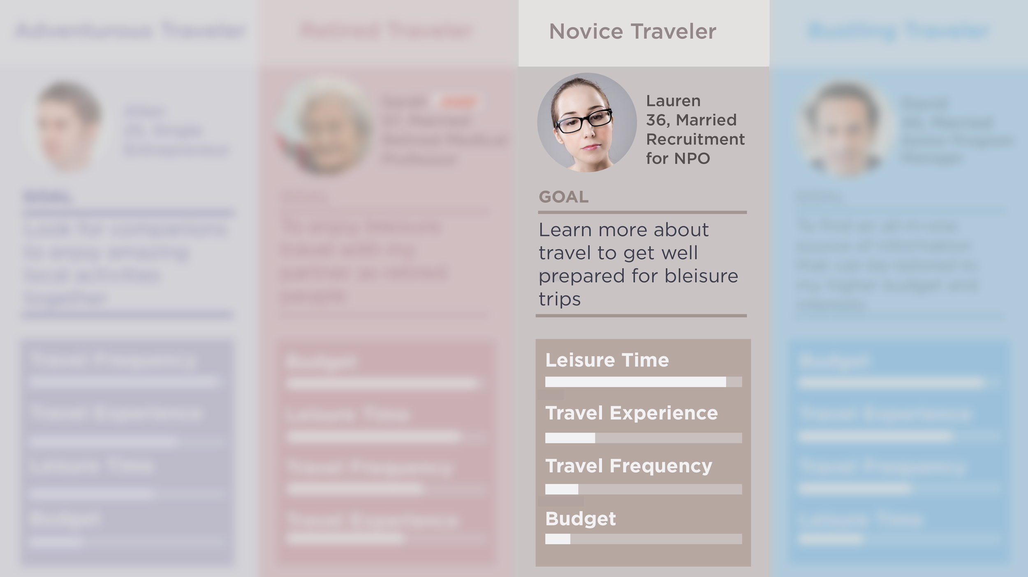

Slide 15
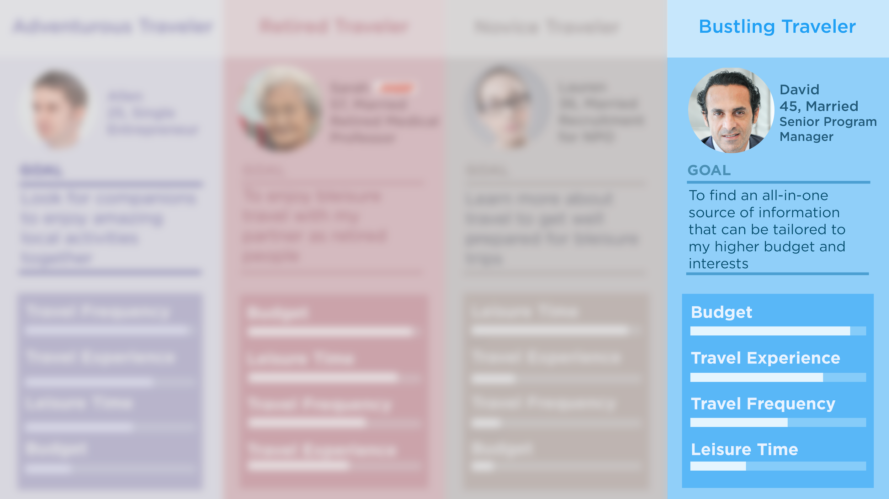

Slide 16
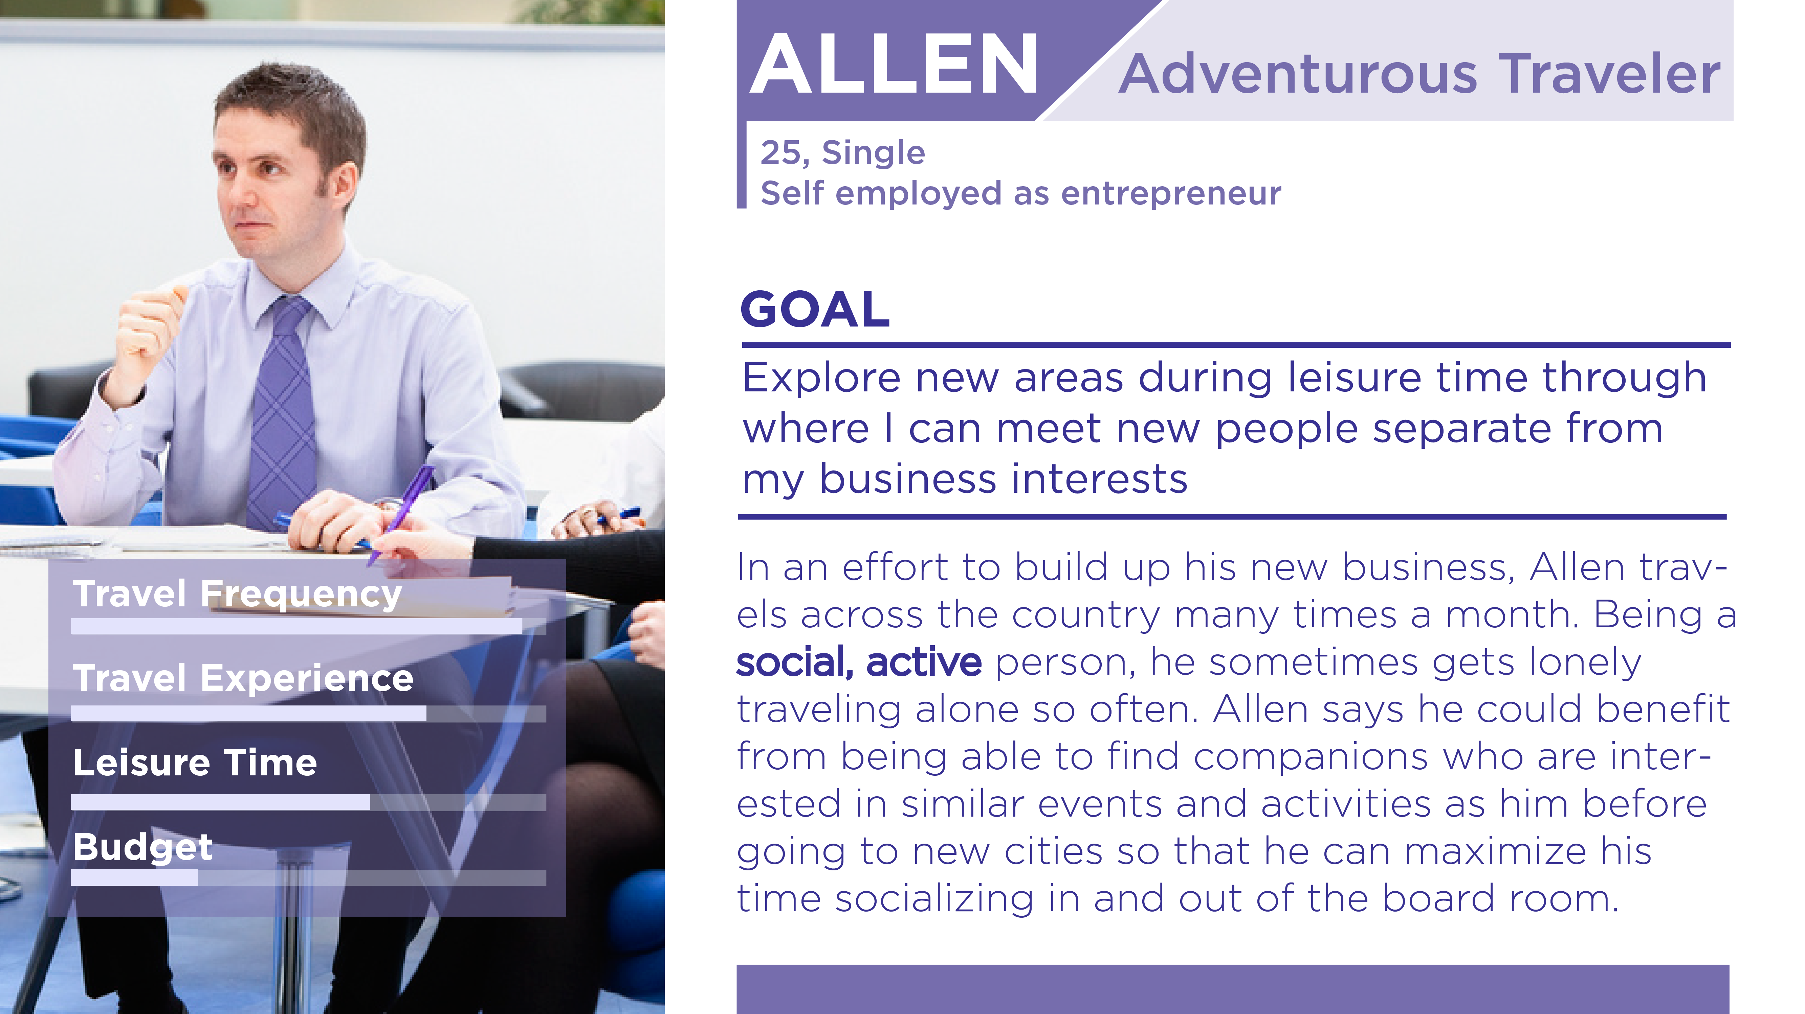
Notes:
persona #1

Slide 17
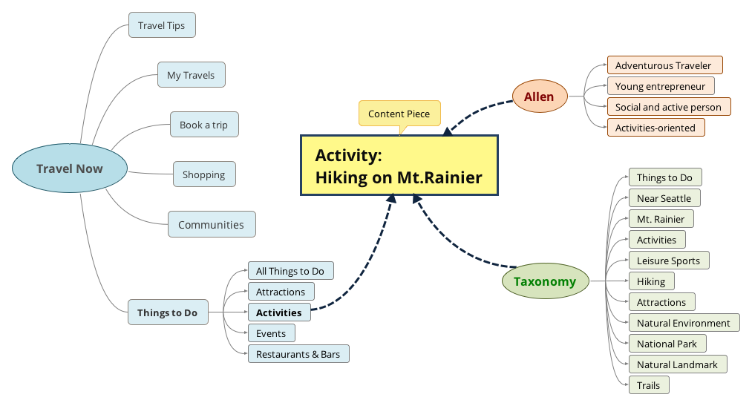
Notes:
content map #1
Allen - things to do - activity

Slide 18
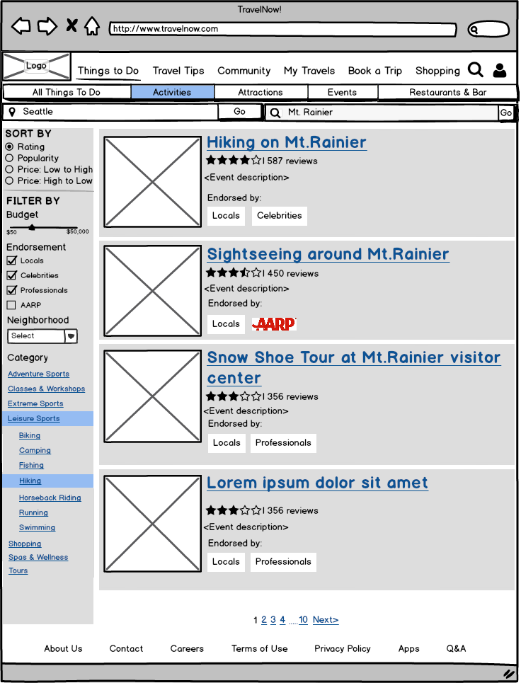
Activities Wireframe

Slide 19
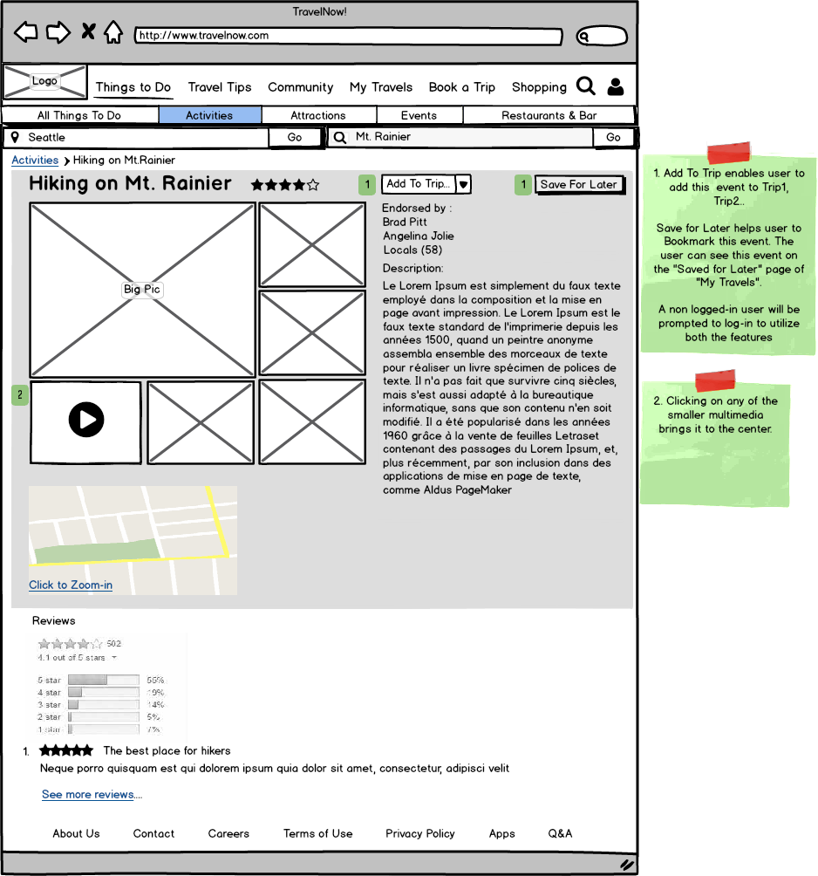
Activities Wireframe

Slide 20
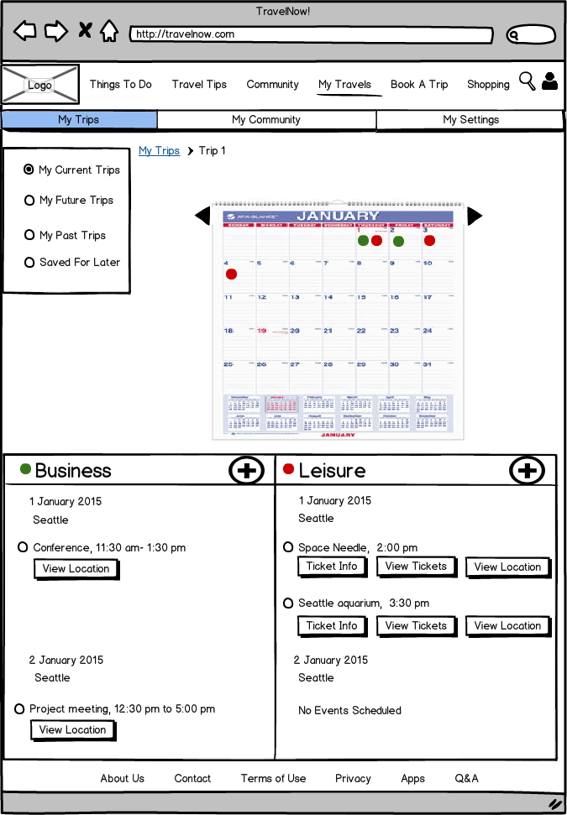
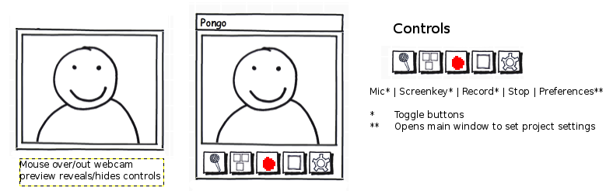
My Current Trips Wireframe
Sync To Calendar

Slide 21
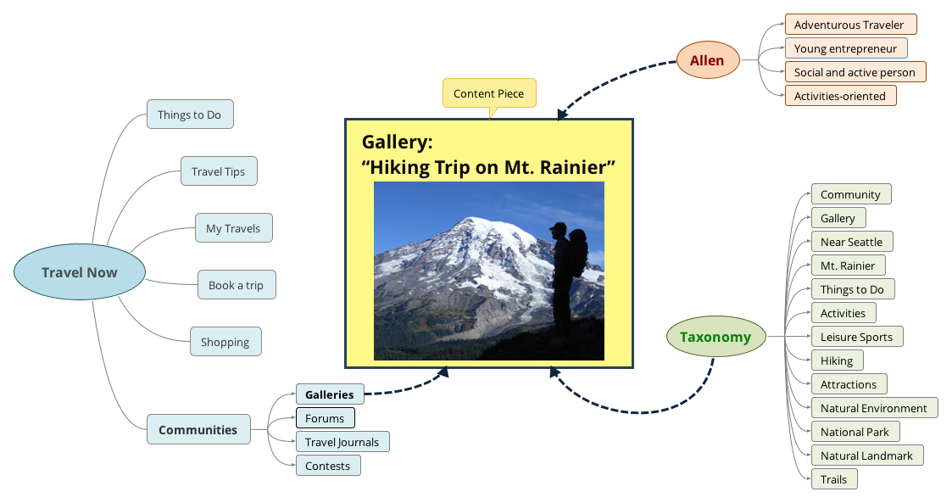

Slide 22
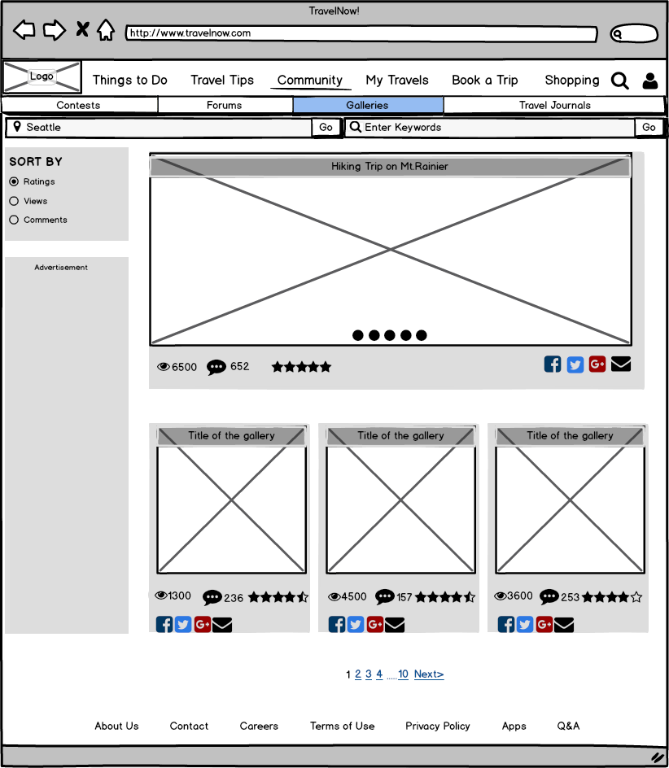
Galleries Wireframe

Slide 23
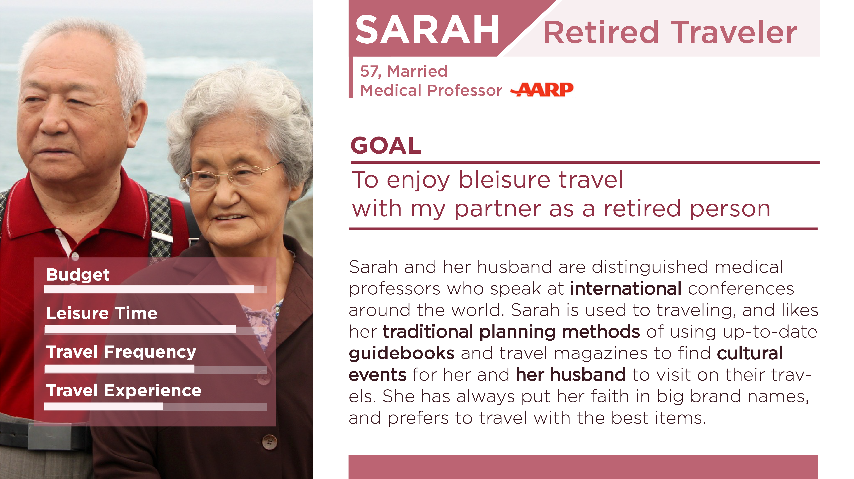

Slide 24
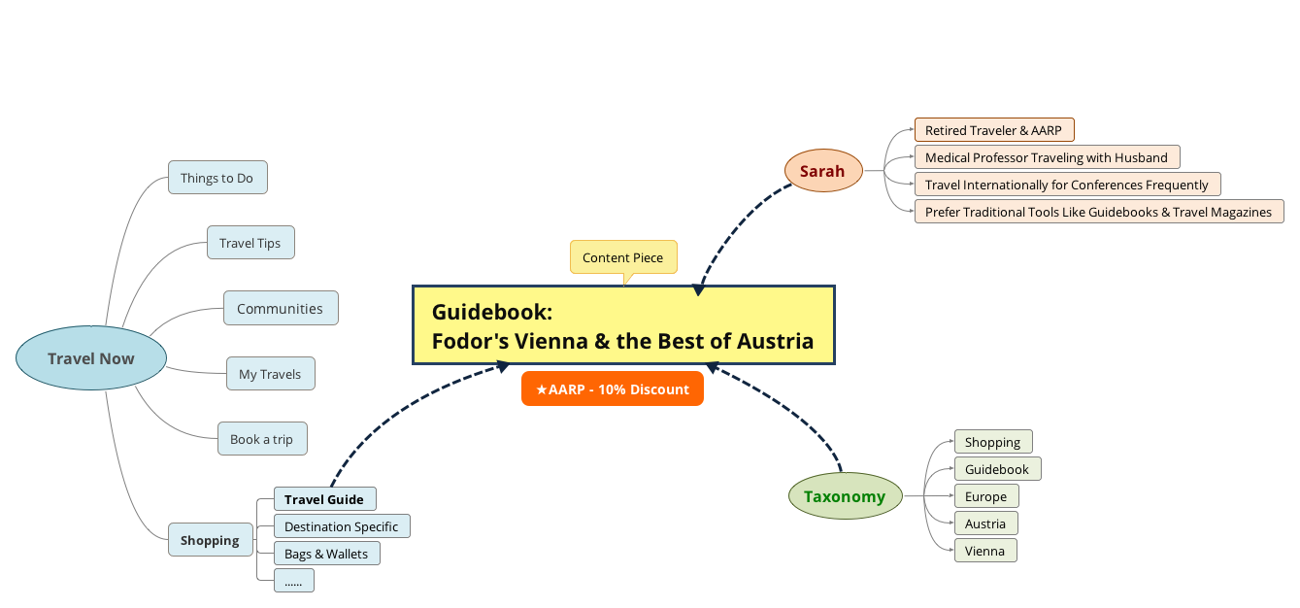

Slide 25
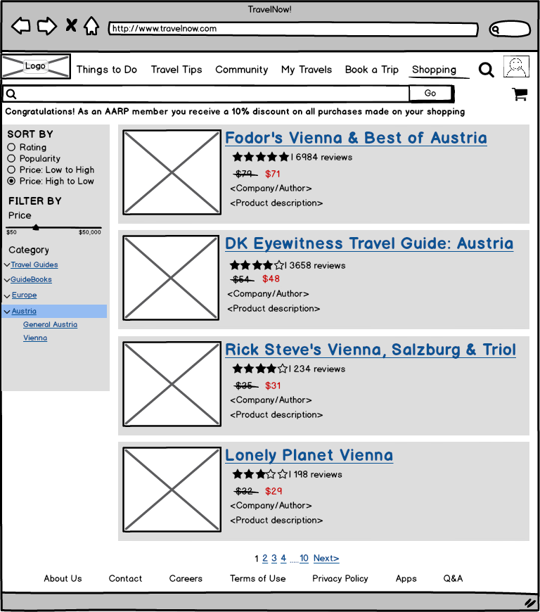
Shopping Wireframe

Slide 26
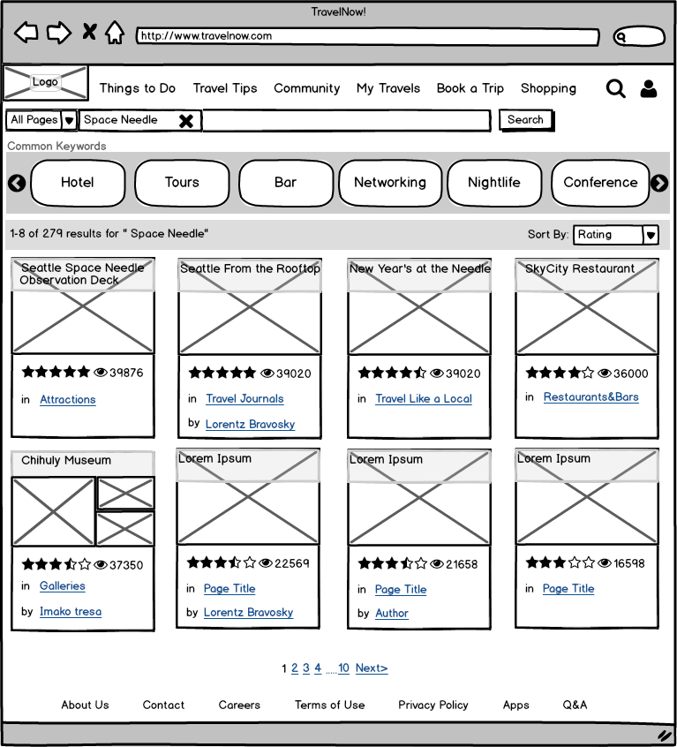
Search Wireframe

Slide 27
LESSONS LEARNED
5
Business travelers look for an information space which well integrates the business and leisure components of their trips
Most users prefer using the computer/laptop vs mobile phones for travel planning
Business travelers look for local activities and events to engage in and enjoy
Users want to integrate travel itinerary and activities onto a calendar app
Users wants to know the attraction spots and budget plan before planning itinerary
Users want reviews and recommendations made by seasoned travelers and locals
Our research shows that the term ‘Bleisure Travel’ can be polarizing

Slide 28


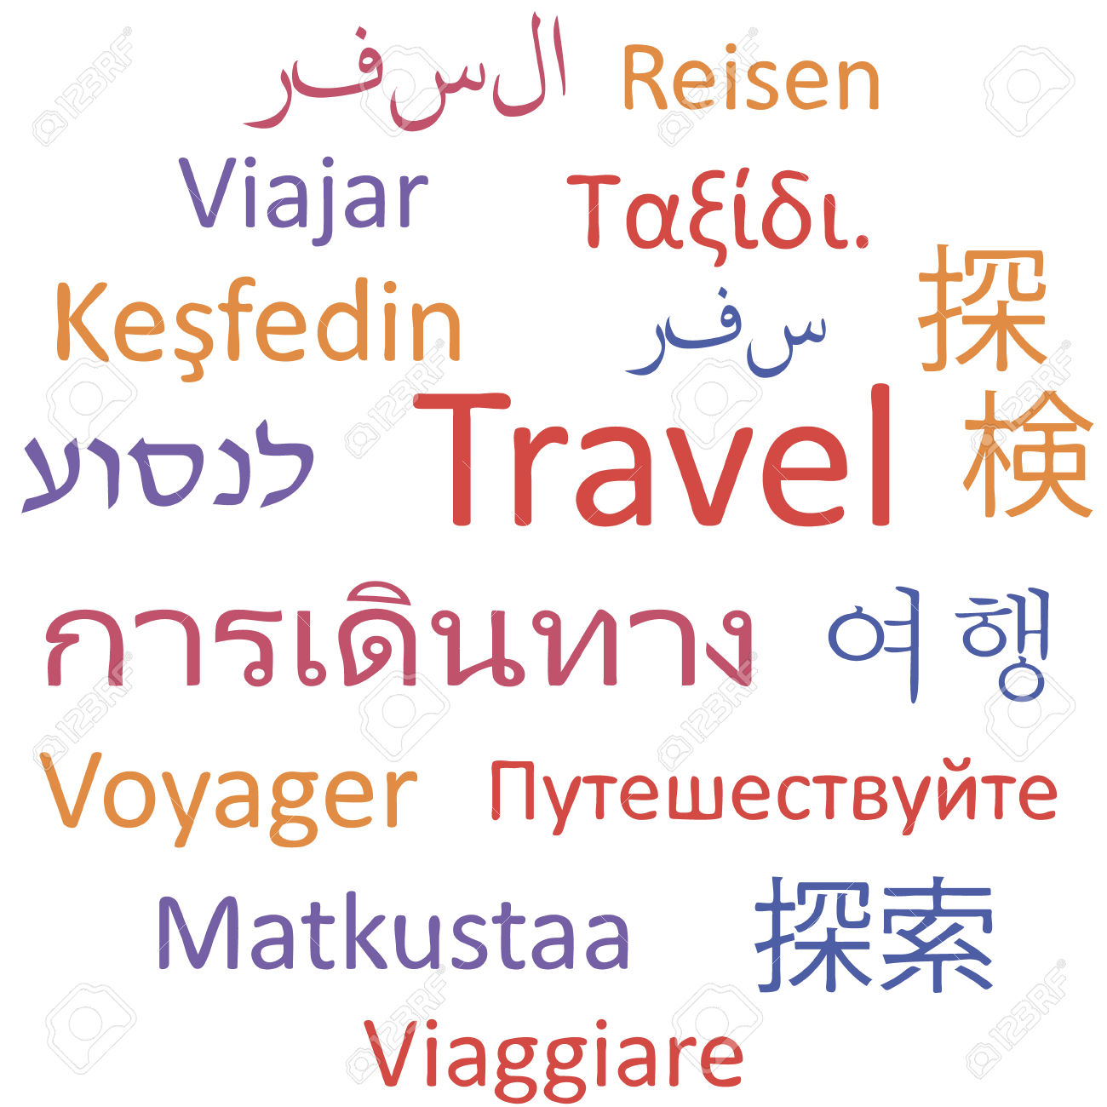

FUTURE SCOPE
6
More B2B relationships for endorsements
Prototype testing to observe users’ desire lines and incorporating changes to information organization & navigation
Develop a parallel mobile application to meet the needs of our on the go bleisure travelers
Including international languages to better cater a global audience

